Slide 1
ANZ Bank 3-month Transaction Analysis
File created on: 2/18/21 12:28:29 PM EST

Slide 2
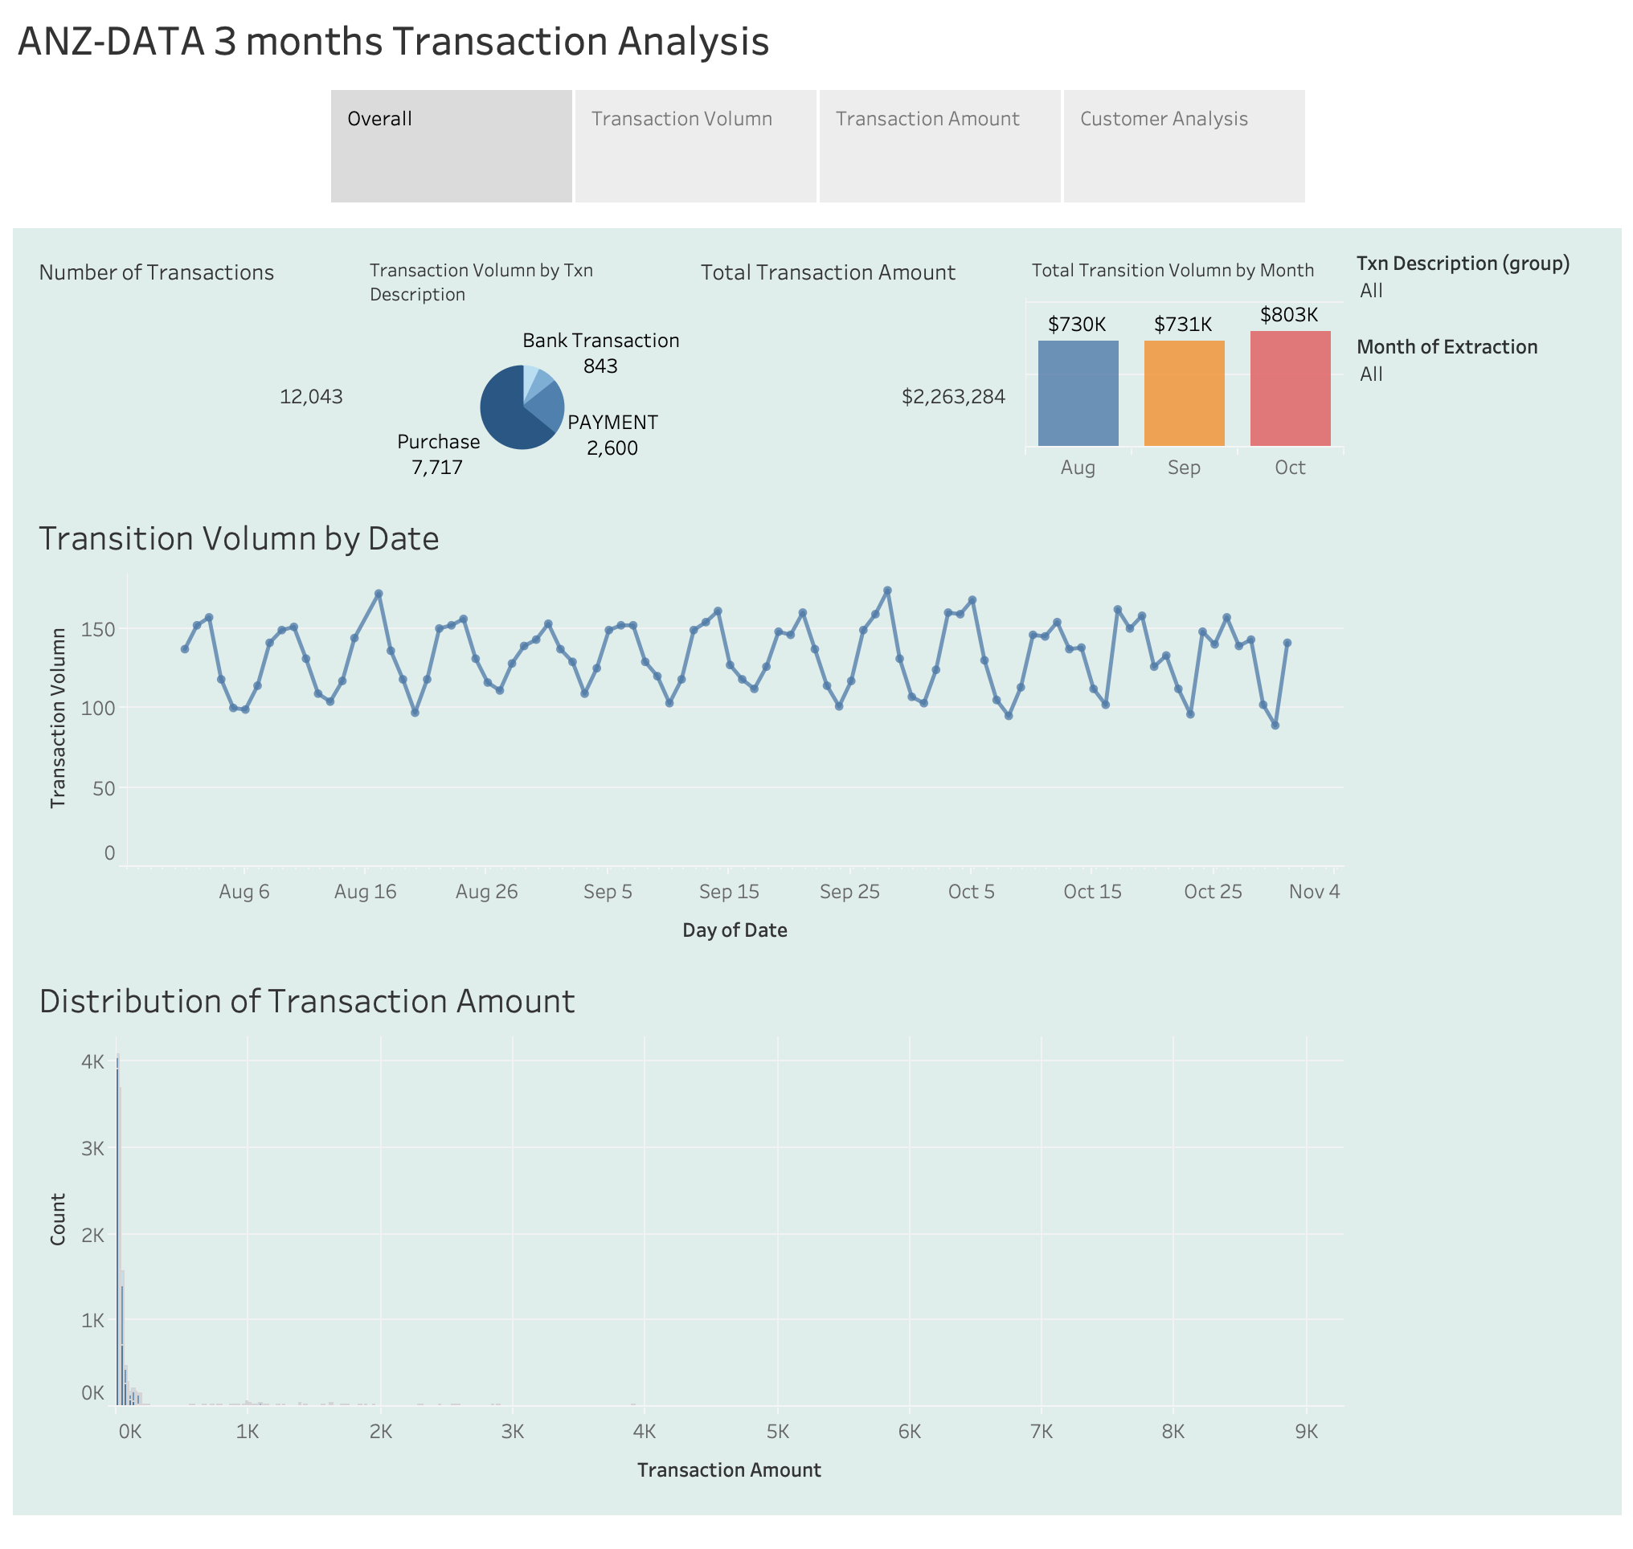

Slide 3
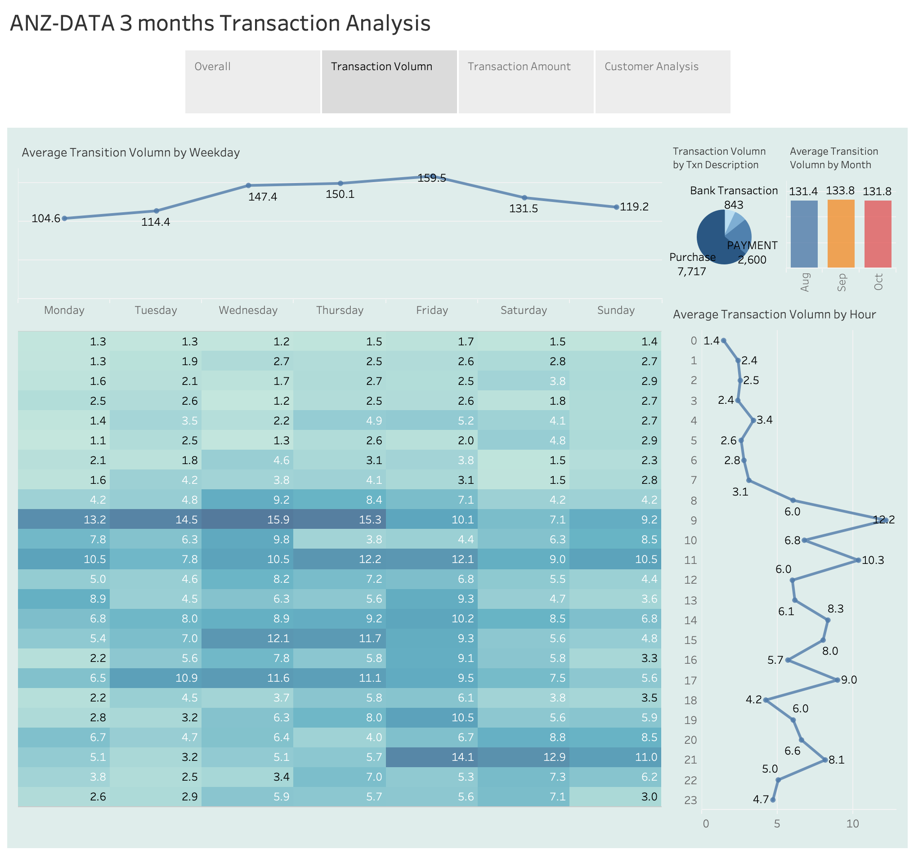

Slide 4
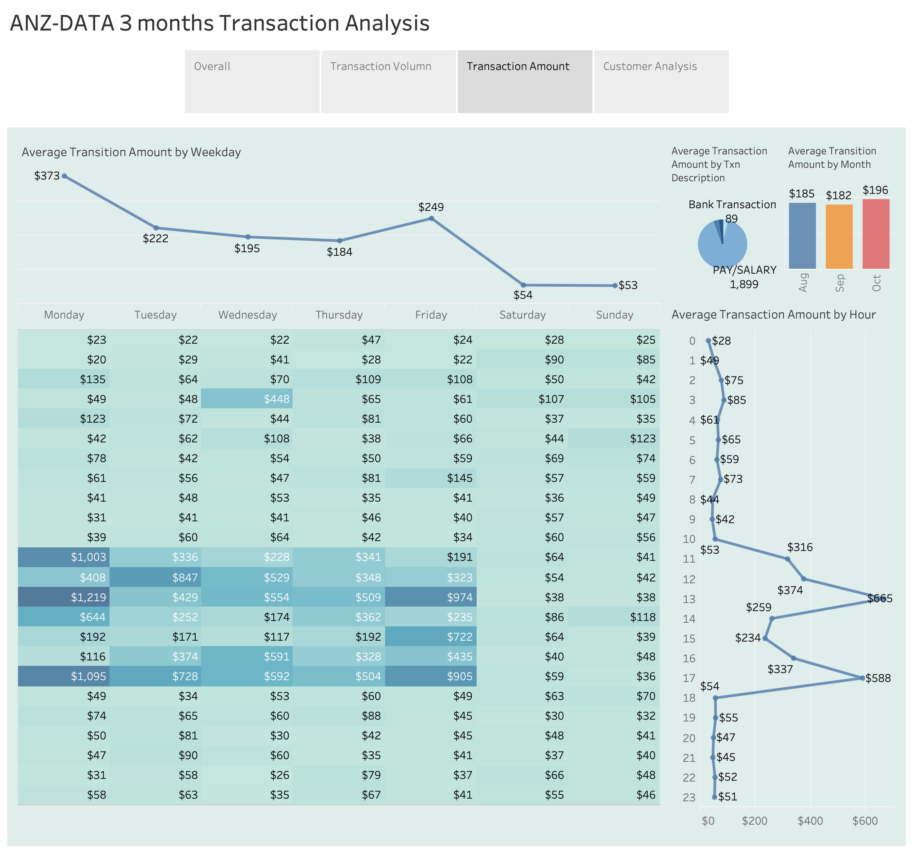

Slide 5
